Slide 1

Income Evaluation
Shivansh jha

Slide 2
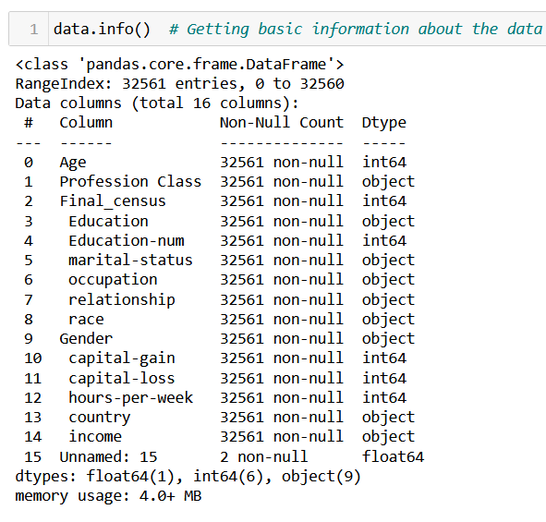
Problem Statement
Data: Income evaluation for different countries.
Based on the available features, build a model to predict whether a person's income exceeds a certain threshold (e.g., <=50K or >50K), which will help to identify the factors that contribute to higher incomes.

Slide 3
Data Cleaning for EDA
The following steps were taken for cleaning data before EDA.
Removing the unnamed column.
Removing extra spaces from the entire dataframe.
Treating the missing values.
Dropping duplicate rows.

Slide 4

Exploratory Data Analysis

Slide 5
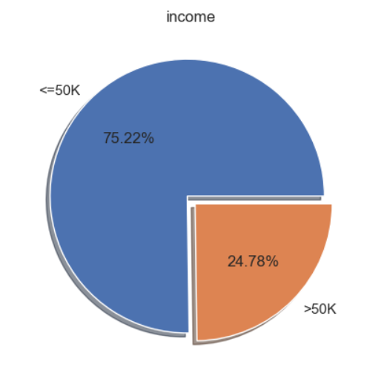
Univariate Analysis
Income Column
This is our target variable & will be considered as Y.
The data has class imbalance as the target column has more than three fourths of the values as '<=50K'.

Slide 6
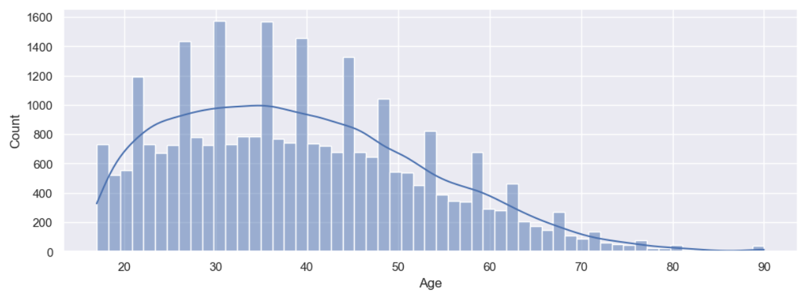
Univariate Analysis
Age Column
Age column is right-skewed, which makes sense as the number of earning people is less after the age of 60 (retirement age in many places).
Bulk of the population ages between 20 and 45.

Slide 7
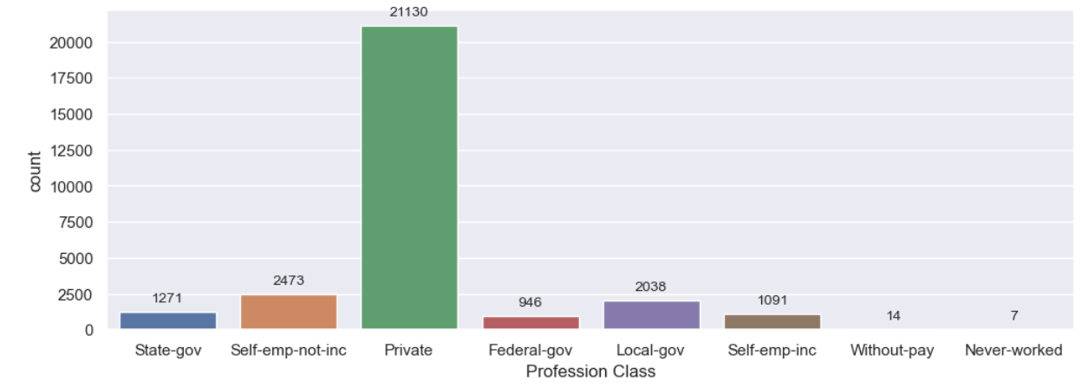
Univariate Analysis
Profession Class column
The most common Profession Class is Private. It is almost 8-9 times more common than the next most common category.
This makes sense because most of the jobs available are in private sector.

Slide 8
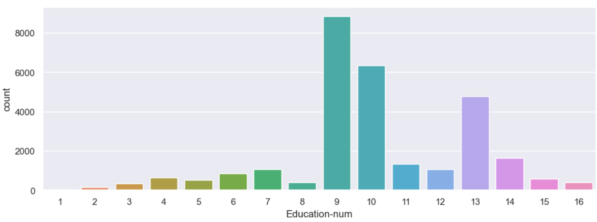
Univariate Analysis
Education-num column
Majority of the people have spent more than 9 years on education.
From the Education column, we know that 9-10 years of education which is the most common indicates HS-grad followed by some-college.

Slide 9
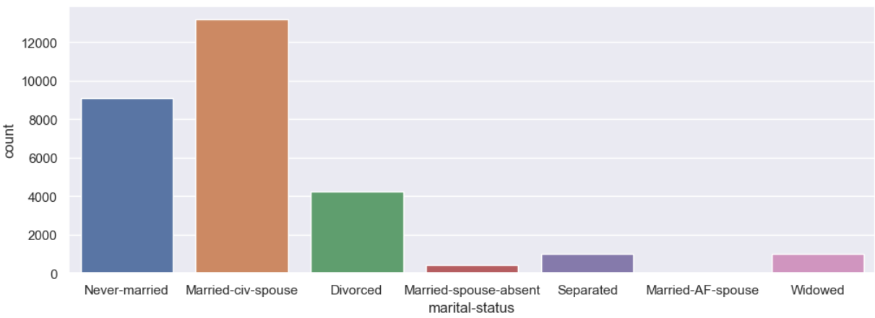
Univariate Analysis
Marital-status column
Majority of the people have marital status as 'Married-civ-spouse' and the least people have status as 'Married-AF-spouse’.
This may be because most people have civilian spouses and having a spouse in Armed Forces is rare.

Slide 10
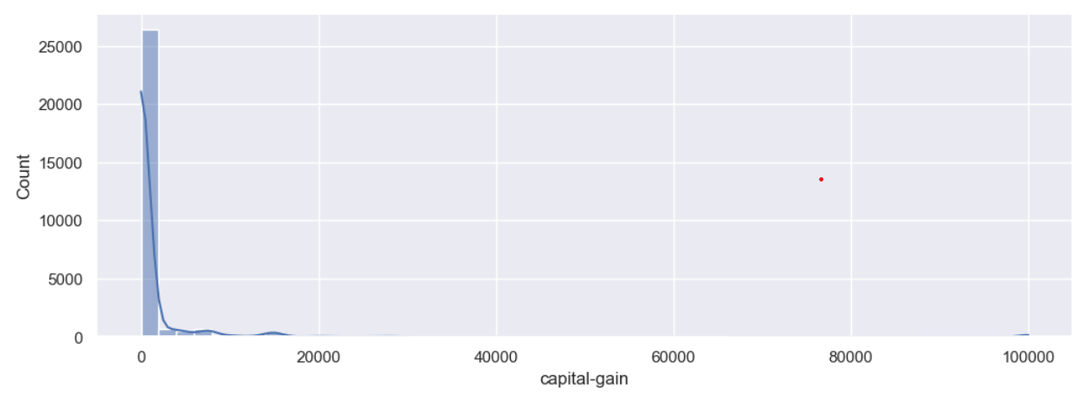
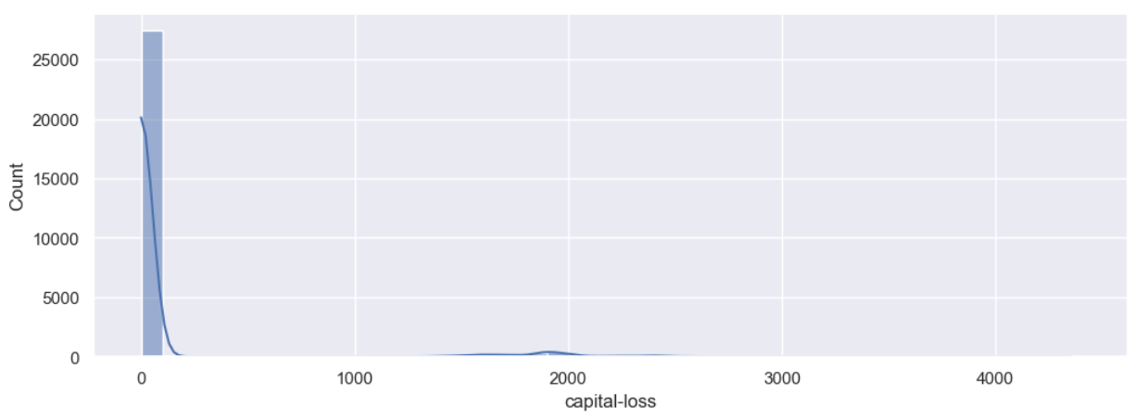
Univariate Analysis
Capital-gain column
Capital-loss column
This column is highly right skewed. People haven't earned much profit while selling capital assets.
Capital-loss column is similar to capital-gain column and is highly right skewed with most of the values as 0.

Slide 11
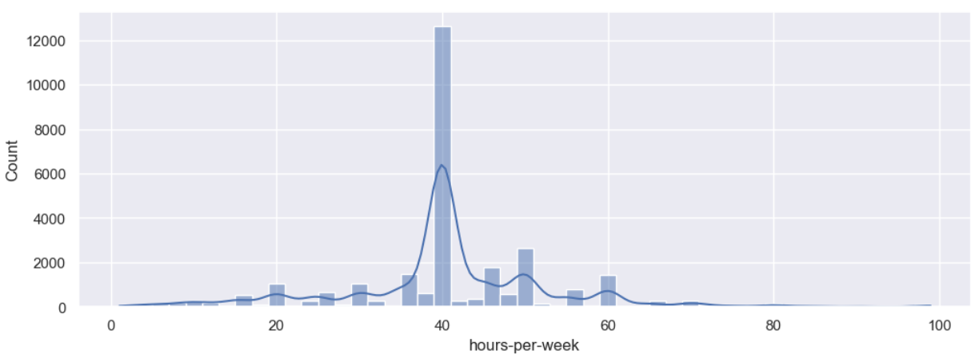
Univariate Analysis
Hours-per-week column
The highest peak is observed at 40 hrs./week which is the usual 8 hrs./day for 5 days a week.
This column doesn't seem to have much skewness and there are smaller bars both to the left and the right of 40.

Slide 12
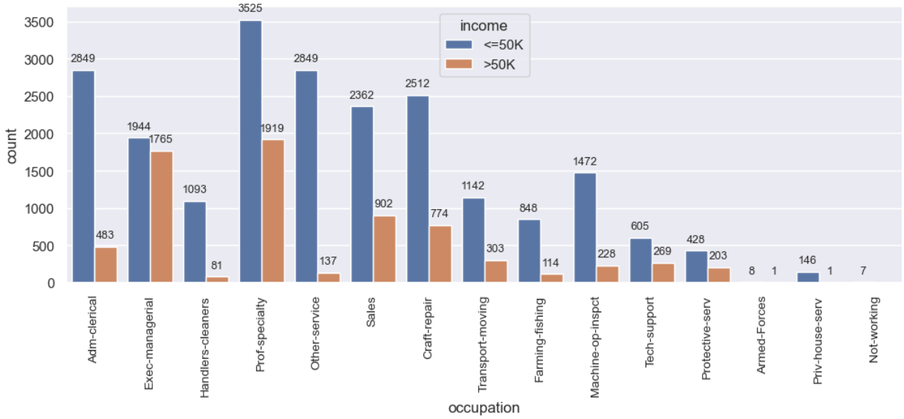
Bivariate Analysis
Occupation and Income columns
People with occupation as Exec-managerial have most chances of earning more than 50K which makes sense because managers and executives are usually paid more.
Still prof-specialty has more people earning more than 50K because of the higher count.

Slide 13
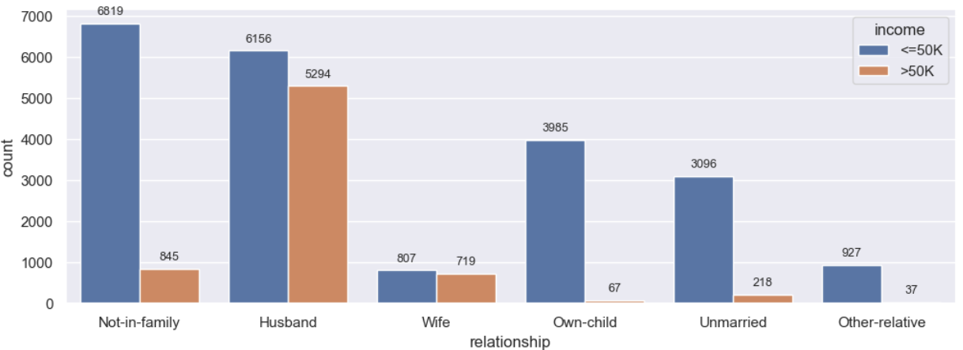
Bivariate Analysis
Relationship and Income columns
This shows that married people (be it husband or wife) have more chances of earning more than 50K.

Slide 14
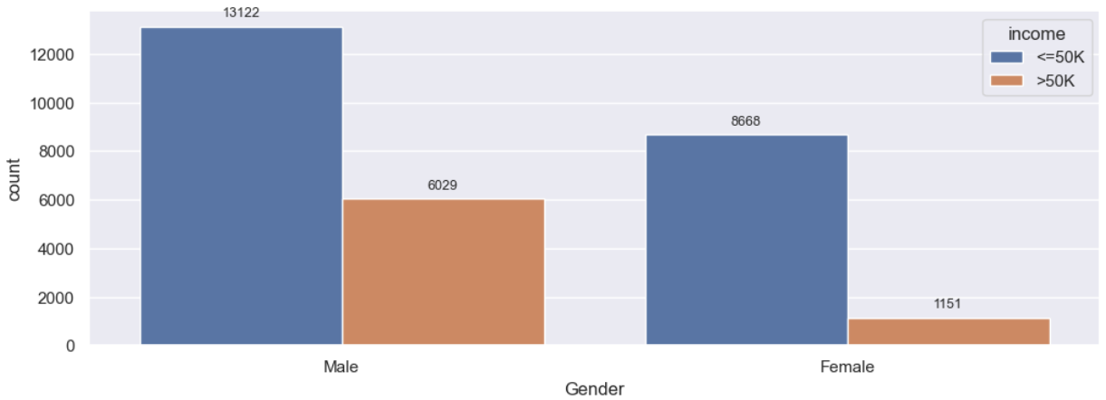
Bivariate Analysis
Gender and Income columns
This shows that males have a better chance at earning more than 50K compared to females.

Slide 15
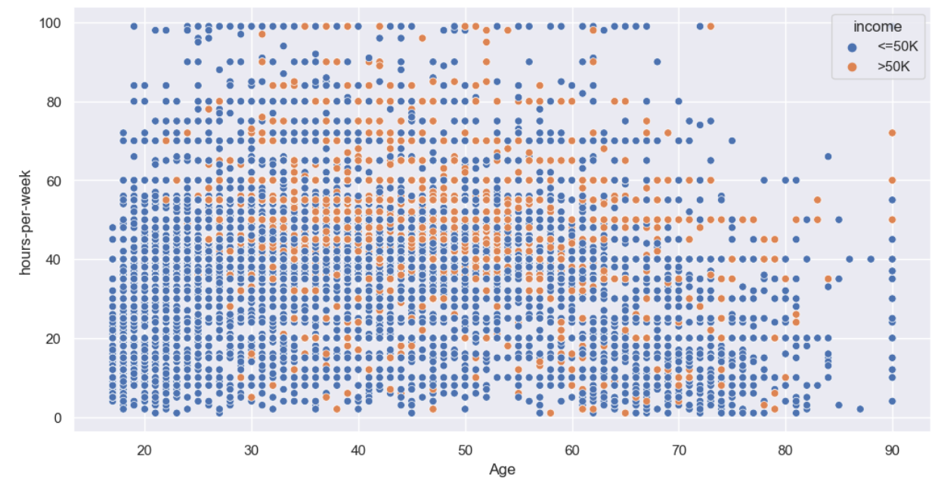
Multivariate Analysis
Age, Hours-per-week and Income columns
Probability of earning more than 50K is more for people with age more than 30.
For younger people, they need to work for 60 hrs./week or more to earn more than 50K.

Slide 16
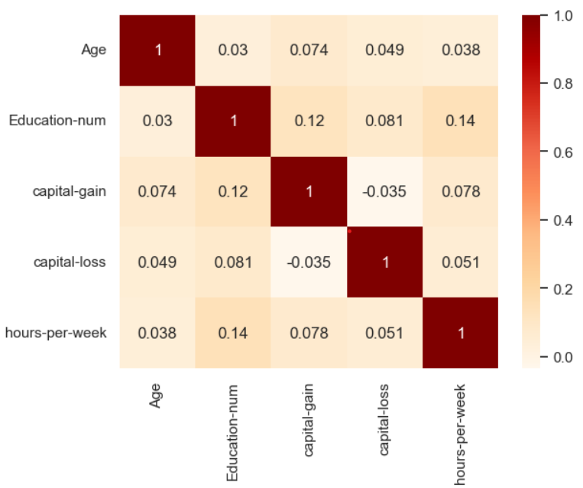
Multivariate Analysis
Correlation Matrix
There is no strong correlation between two features.
All the columns can be taken forward for Model Building.

Slide 17

Data Modelling

Slide 18
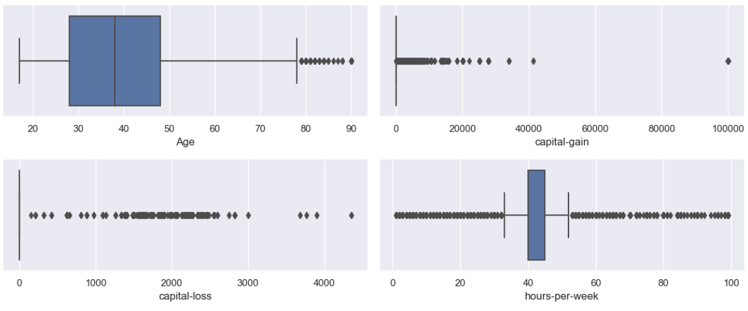
Outlier Detection
Columns Age and hrs-per-week don't have outliers but column capital-gain needs to be treated.
We will ignore capital-loss for now as the outliers aren’t extreme.

Slide 19
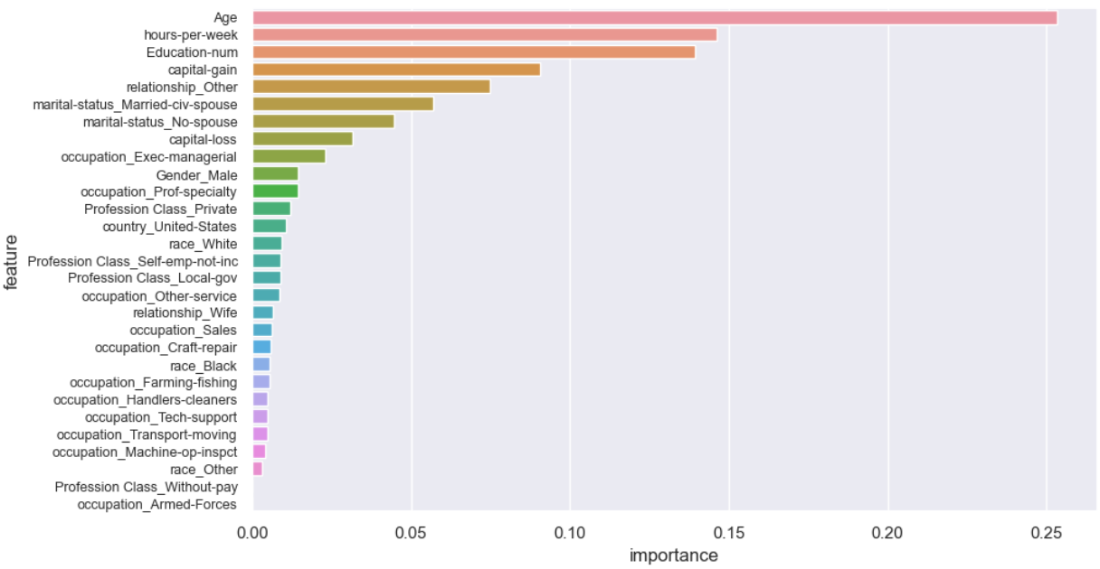
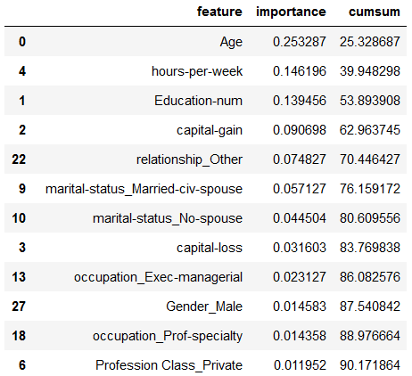
Feature Importance
This graph is plotted using sklearn.ensemble.ExtraTreesClassifier.

Slide 20
Model Comparison
Model | Training accuracy | Testing accuracy
XGBClassifier | 86.4% | 85.4%
Random Forest Classifier | 85.8% | 84.7%
Decision Tree Classifier | 85.2% | 84.7%
SVC | 83.9% | 83.2%
Logistic Regression | 81.9% | 82.5%
K-Neighbors Classifier | 84.4% | 81.5%

Slide 21

THANK YOU

